Slide 1

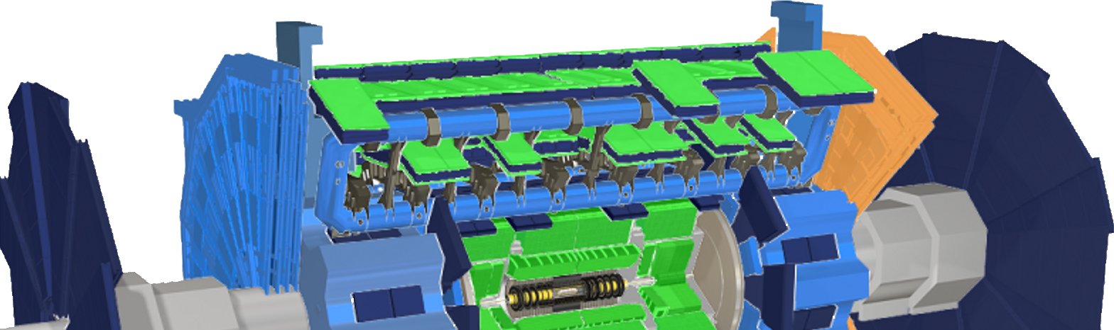
Shift Training:
Detector Control System
Stefan Schlenker, CERN
for ATLAS DCS

Slide 2
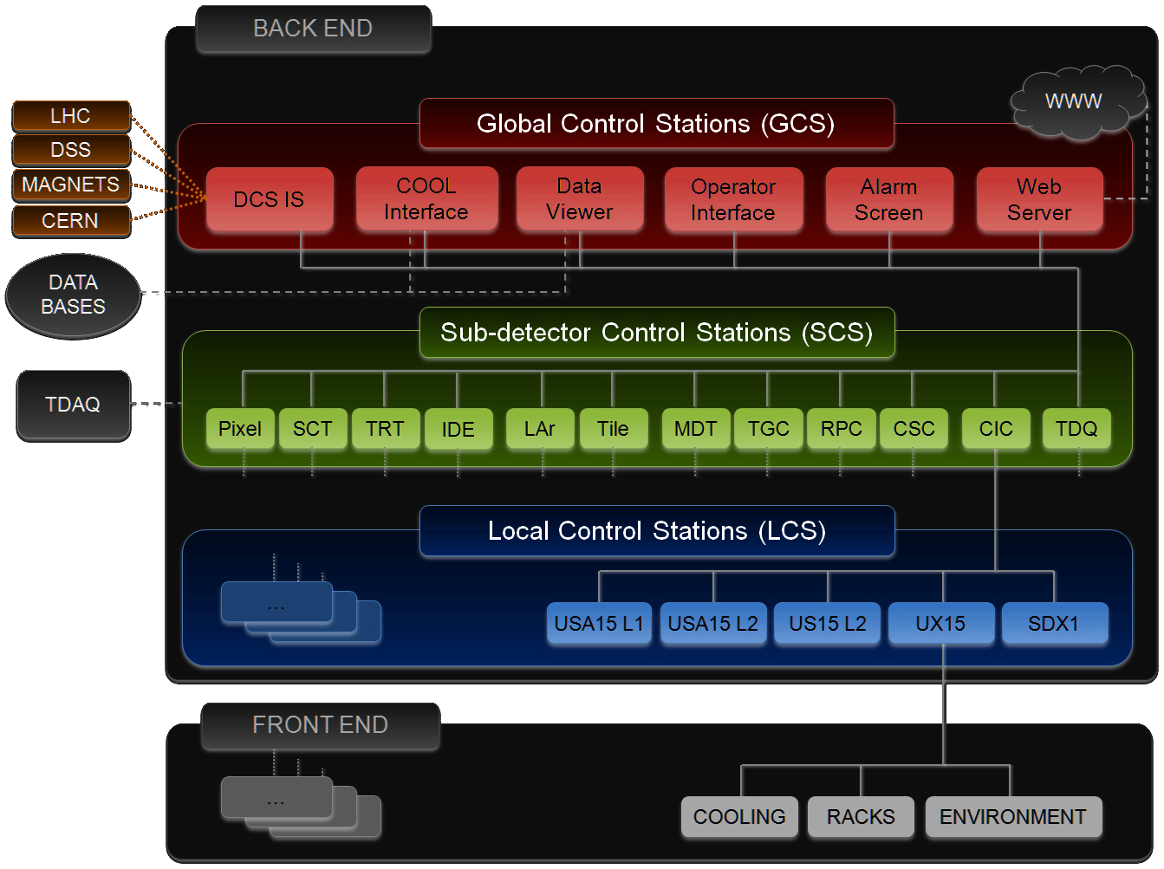
ATLAS DCS Overview
Function & Architecture
Monitor and control detector operation
Total >10⁷ parameters distributed over >130 LCS (rack servers)
Archiving of selected parameters to Oracle database
Interfaced with DAQ/RunControl
Links to external controls systems (LHC, Infrastructure)
Remote access: direct and via web applications
System | Component | # Servers (# Appl.) | # Archived Parameters | Total # Parameters | # FSM Objects
Inner Detector | Pixel | 11(12) | 57k | 1’086k | 9.1k
 | Silicon strips | 11(11) | 106k | 1’265k | 14.7k
 | Transit. radiation | 11(11) | 69k | 123k | 13k
 | Services | 7(8) | 16k | 494k | 3.7k
Calorimeters | Liquid Argon | 13(13) | 27k | 910k | 8.3k
 | Tile | 5(5) | 51k | 719k | 2.4k
Muon Spectrometer | Drift tubes | 29(29) | 214k | 3’229k | 19.2k
 | Cathode strip | 2(2) | 1.3k | 109k | 0.6k
 | Resistive plate | 7(7) | 139k | 1’597k | 2.5k
 | Thin gap | 7(7) | 81k | 1’225k | 10k
 | Services | 2(2) | 0.7k | 55k | 0.04k
Forward detectors |  | 4(4) | 4.9k | 194k | 0.9k
Common Services | Counting rooms | 7(7) | 23k | 568k | 4.7k
 | Trigger & DAQ | 2(2) | 11k | 386k | 1.3k
 | External+safety | 4(6) | 8.0k | 144k | 0.4k
 | Global services | 9(13) | 1.2k | 222k | 0.4k
Total |  | 131(139) | 809k | 12.3M | 91.2k

Slide 3
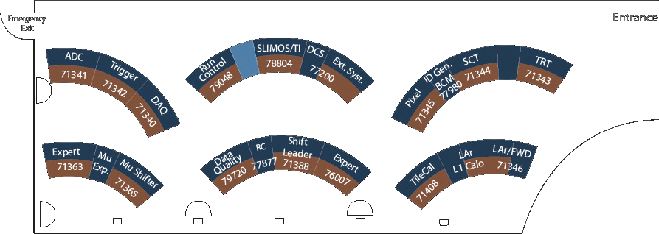
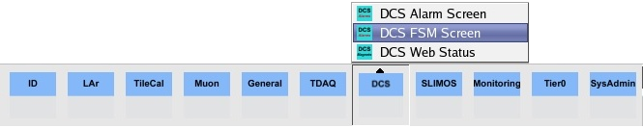
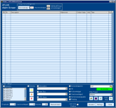
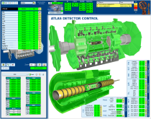
Operation in ACR
Interfaces
Finite State Machine (FSM) and Alarm Screens
1
2

Slide 4

Desk Details
DCS Desk pc-atlas-cr-dcs
Shifter Desk pc-atlas-cr-*
Global FSM
Control
Alarms
Alarms
FSM
LHC FSM
ACR Stations
DCS desk: Global FSM for Control, FSM ownership, global Alarms
Shift Leader desk: Global FSM for Monitoring and LHC interaction (handshake), global Alarms
System Shifter desks: FSM and Alarms for respective system group (ID, CAL, MUON)
Be aware:
All desks: limited # of UIs!! Counts per system, alarm if close to limit

Slide 5
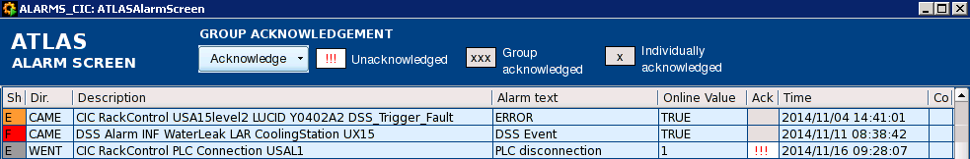
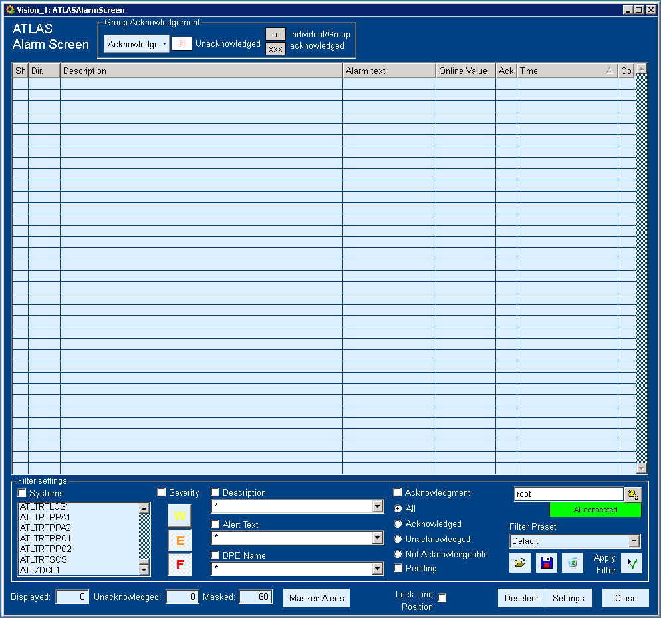
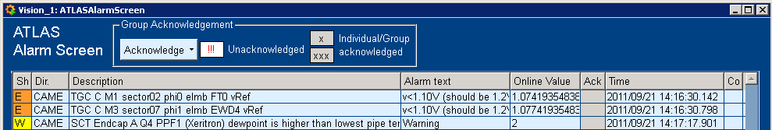
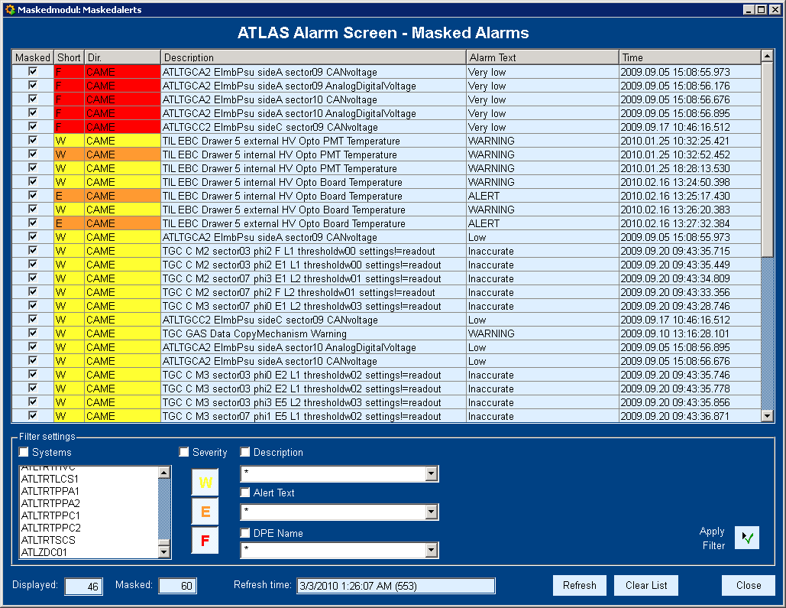
Alarm Screen
Active and non-acknowledged alarms
Alarm = parameter out of good range
Options for each alarm (right-click):
Mask alarm on UI level until the alarm condition goes
Insert alarm to ELOG with comment
Display trend plot of value
Alarm help on TWiki
Acknowledgement:
Only for some alarms
Operator needs to acknowledge (left-click on “!!!”), otherwise they won’t disappear from screen when resolved
Unacknowledged, but resolved alarms are shown as „WENT“ with grey color
Summary alert:
Single alarm entry hiding several alerts of same type (accessible via “Details”)
Filters:
Different sets of filters exist, e.g. sub-detectors
Use always “Default” unless you know what you are doing, always revert back

Slide 6
Finite State Machine (FSM)
State machine hierarchy
Detector hardware represented by FSM objects, hierarchically structured
State&Command propagation
State model for devices (ON,OFF,…) and logical objects (READY, NOT_READY,…)
Propagation upwards (using programmed logic for parent depending on child states)
Commands propagated downwards
Status
Error handling upwards
Object operations
Commands
Enable/disable (low level )
Take/release/include/exclude (high level )
Access control for all operations
User Interface
Browsing and object operation…
Shift
Operator
GCS
Detector
Expert
SCS 1
SCS 2
...
SCS N
TTC
TTC
...
TTC
TTC
1
.
1
1
.
2
1
.
N
N
.
1
LCS
LCS
LCS
LCS
1
.
1
.
1
1
.
1
.
2
N
.
1
.
1
N
.
1
.
2
Sub-sys
Sub-sys
1
.
1
.
2
.
1
1
.
1
.
2
.
2
Dev
Dev
Dev
Dev
Dev
State machine object
Dev
Dev
1
2
3
4
5
N
-
1
N
SCADA / PVSS Layer
GOTO_STANDBY
GOTO_READY
READY
GOTO_SHUTDOWN
GOTO_STANDBY
OK
STATES,
COMMANDS
STANDBY**
WARNING
SHUTDOWN
STATUS
GOTO_ANY
RECOVER
ERROR
NOT_READY
UNKNOWN
TRANSITION
FATAL
**only mandatory for relevant sub-detectors

Slide 7
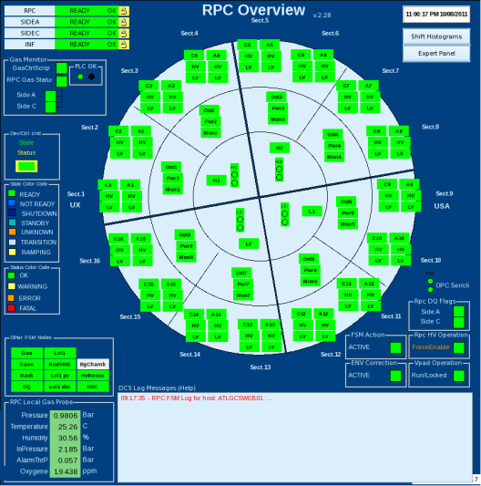
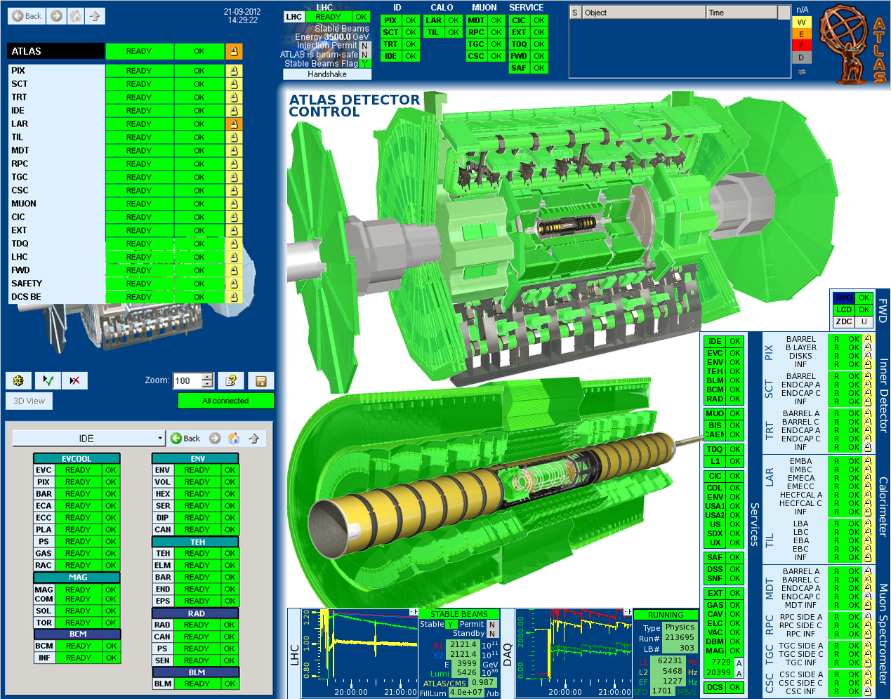
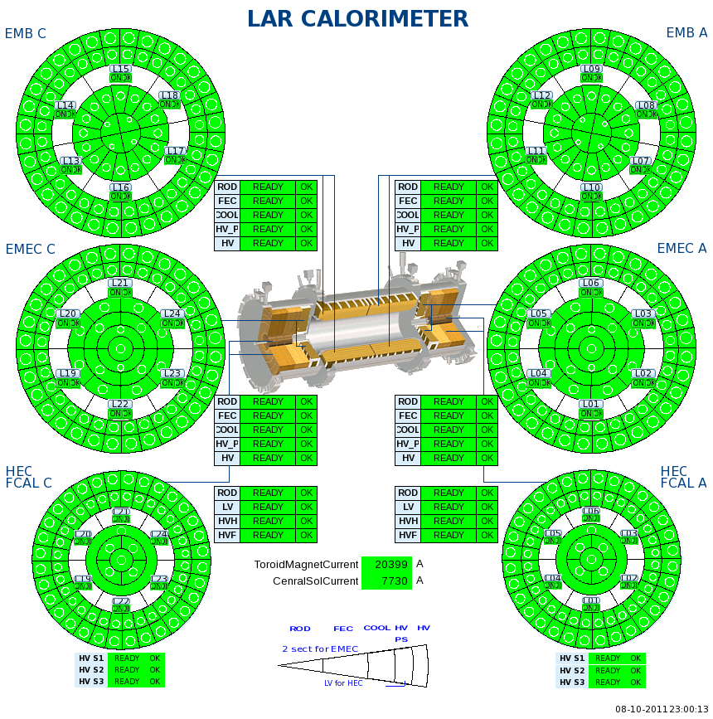
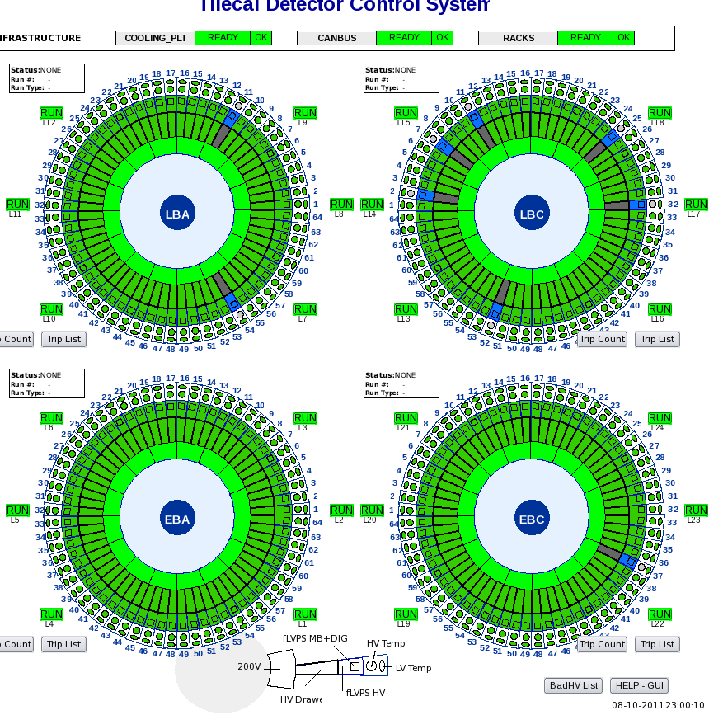
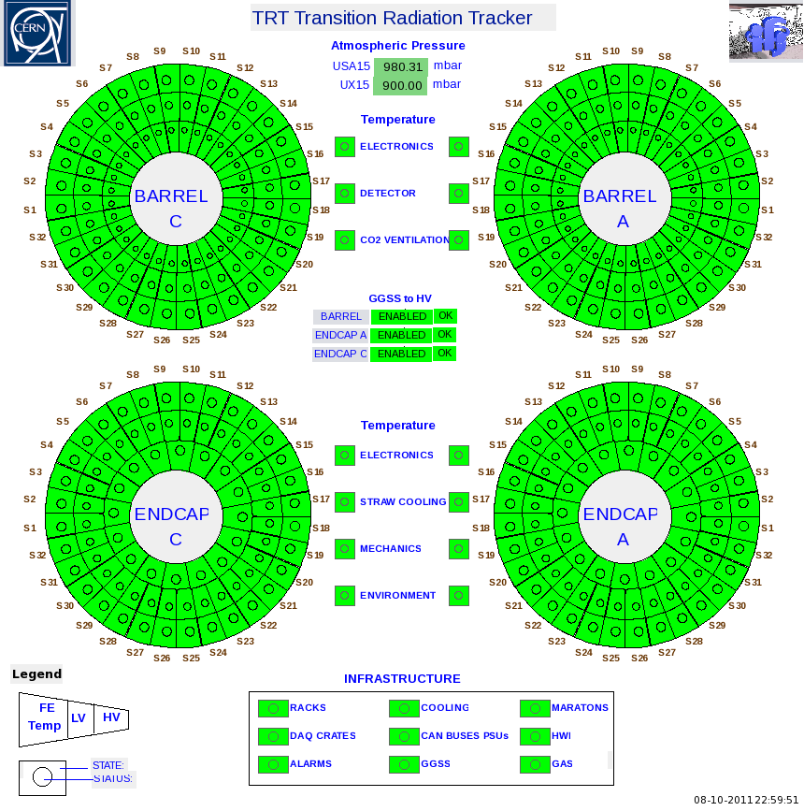
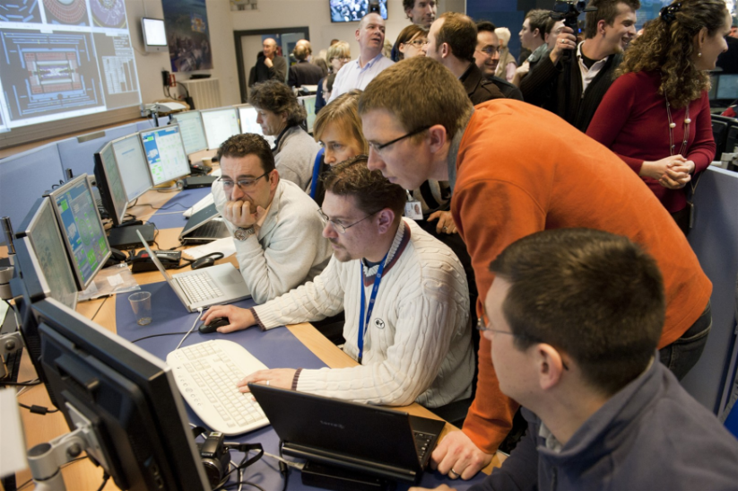

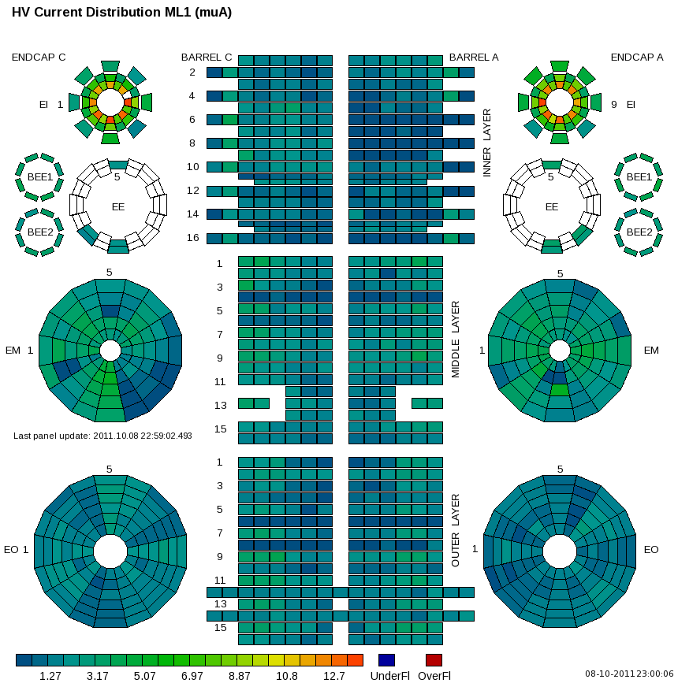
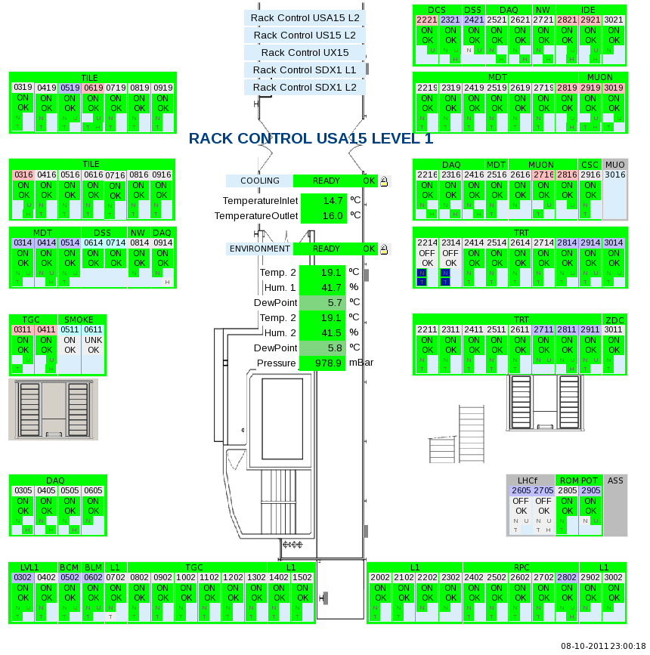
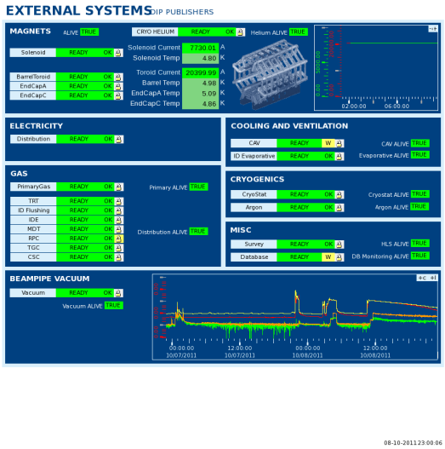
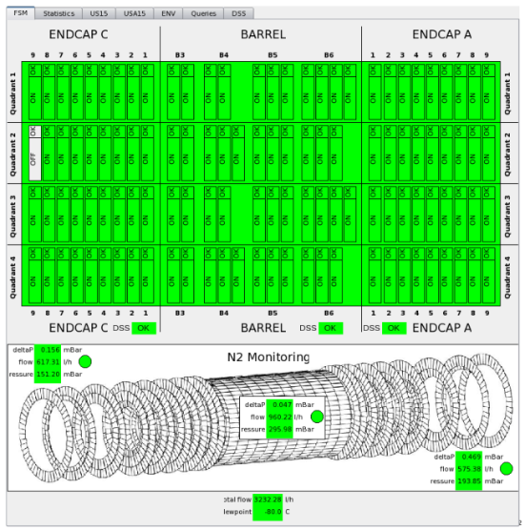
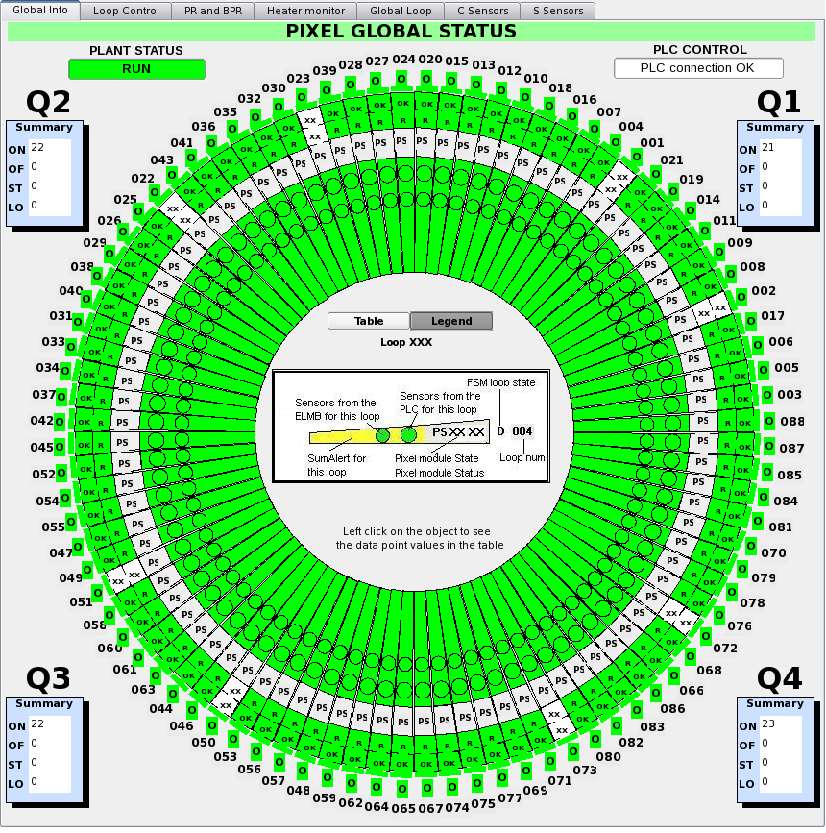
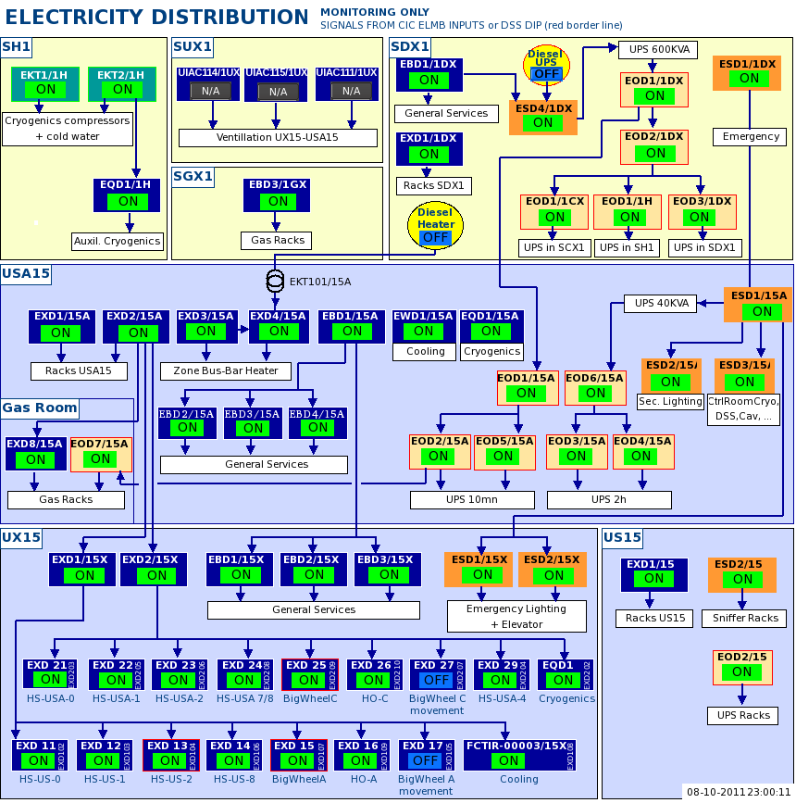
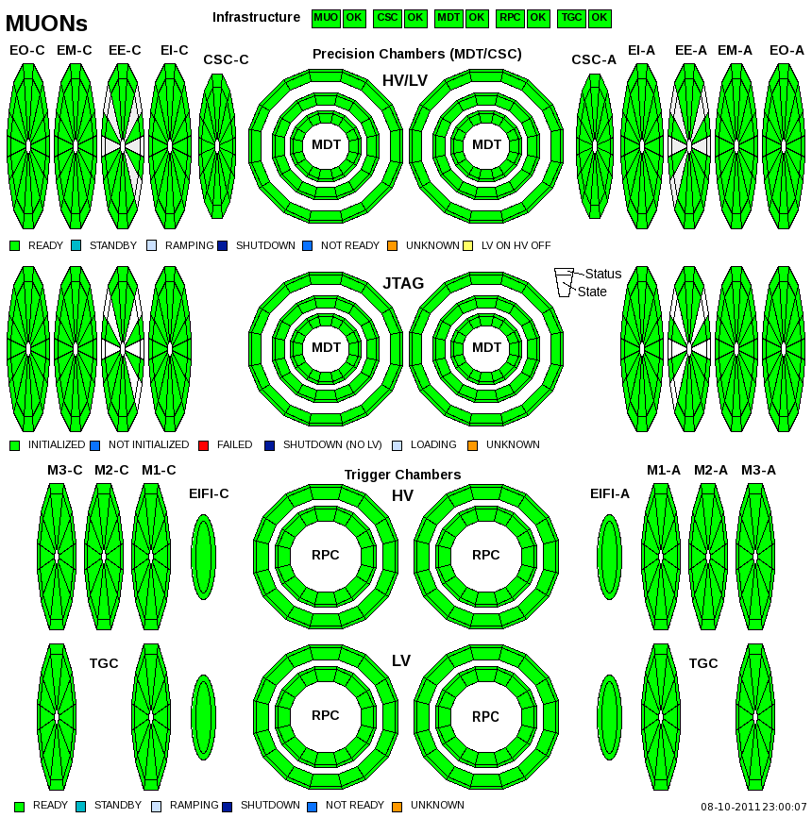
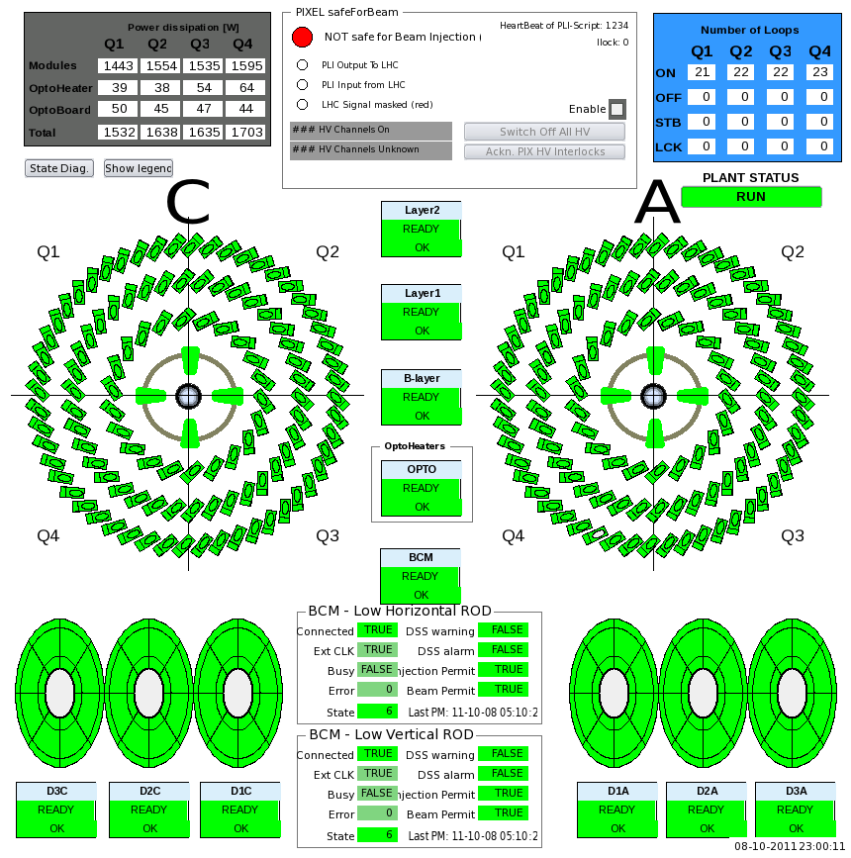
Operator Control
FSM Screen

Slide 8
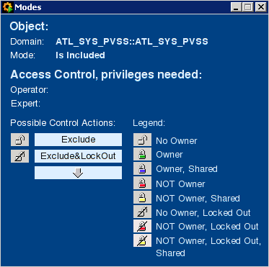
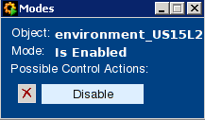
FSM Screen: Partitioning Modes
High level objects:
Change mode with left-click on padlock:
Padlocks:
No control, Free
Exclusive, Owner
Shared, Owner
Exclusive, NOT Owner
Shared, NOT Owner
No control, Locked Out
No control, Included
Padlock background = tree completeness:
Tree complete
Excluded children (!)
Disabled children
➲ Control:
No propagation, NO commands
Propagation (if Included), Commands by you
Propagation (if Included), Commands by all
Propagation (if Included), NO commands
Propagation (if Included), Commands by all
No propagation, NO commands
Propagation, NO commands
Low level objects:
Checkboxes:
Enabled, Controllable
Disabled, Controllable
Enabled, Not controllable (either free or not owned + exclusive sub-tree)
Disabled, Not controllable
Change mode with left-click on checkbox:

Slide 9
Access Control
Aim: prevent accidental actions
Username, Password: CERN account
Shifters get DCS:<sub-det>:operator privileges for shift, thus could:
Mask/acknowledge alarms
Operate FSM objects:
Enable/disable
Take/release/include/exclude (if owner)
Commands
Please use FSM actions only after request by an expert or if stated explicitly in sub-system instructions!
Shift Leader roles/privileges:
DCS:<sub-det>:operator for all sub-dets, but not in sub-domains (e.g. LARHV) as fallback solution
Additionally BIS operator (see Beams training)

Slide 10
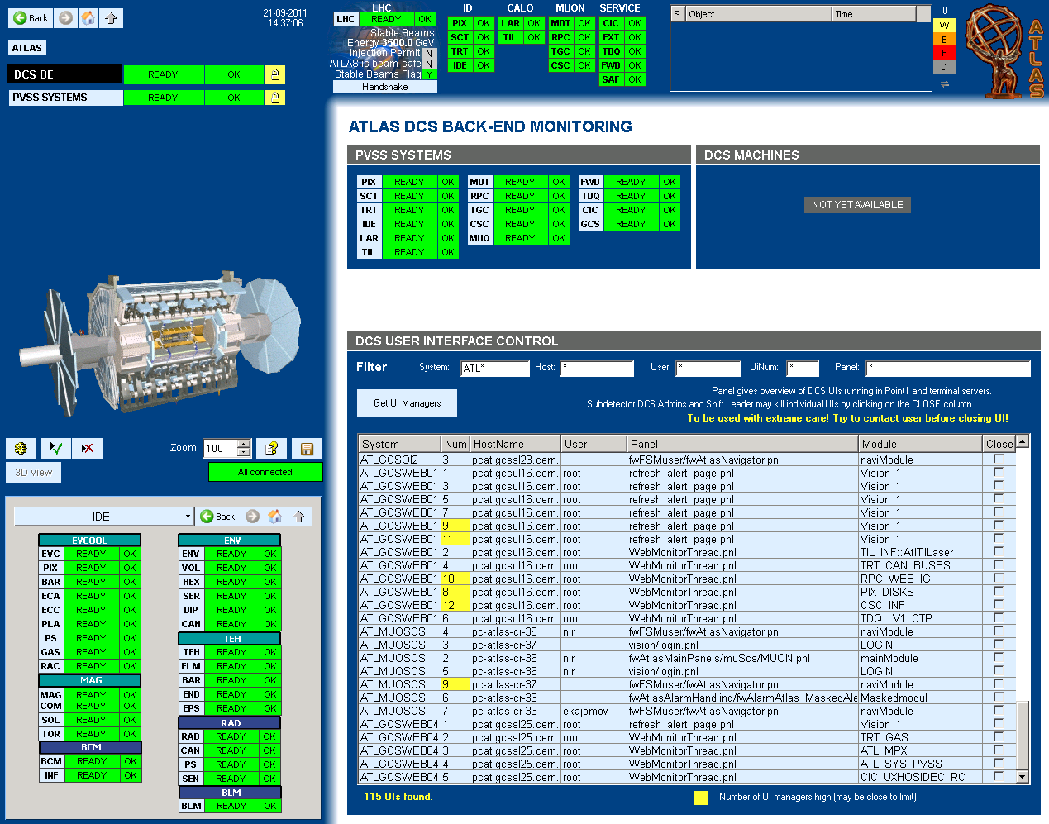
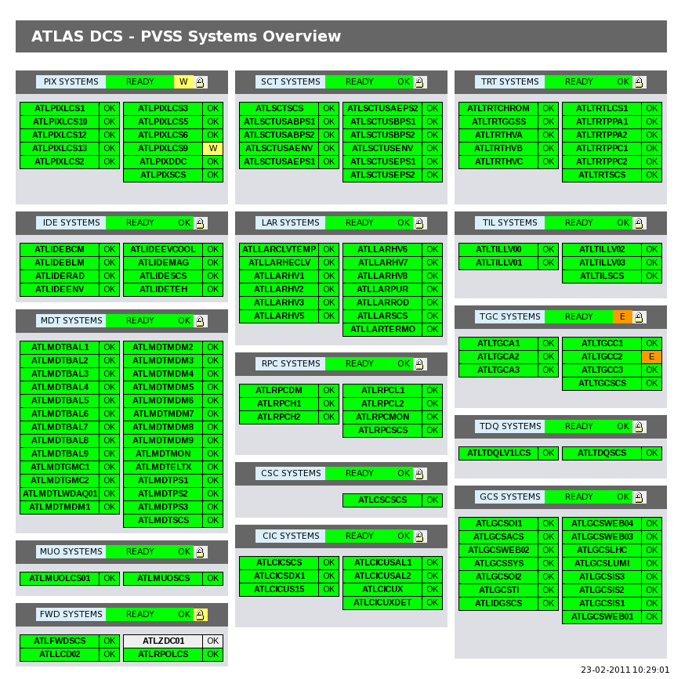
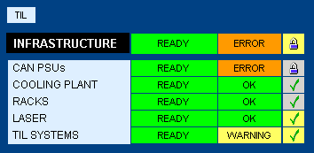
DCS Back-End Monitoring
Monitor state of DCS back-end itself (processes, machines, …)
Accessible on FSM screen
Global: “DCS BE”
Sub-det: “XYZ SYSTEMS”
Control over running panels from within ACR, possibility to monitor and kill (emergency only!) user interfaces by shift leaders
Follow up of problems only by DCS experts (sub-detector or central)

Slide 11
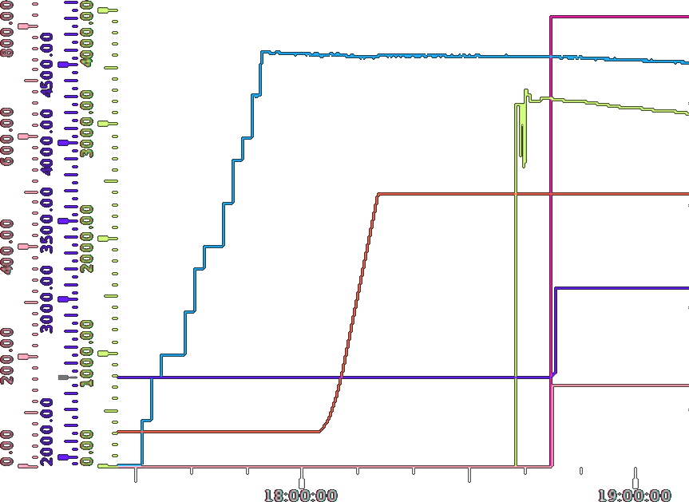
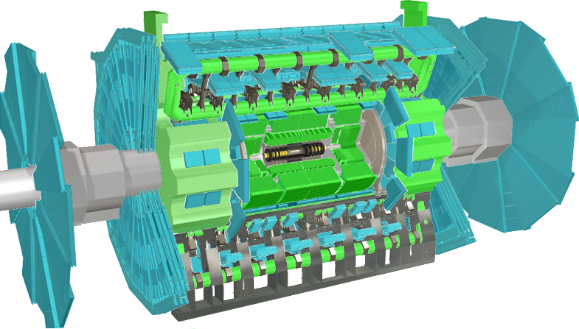
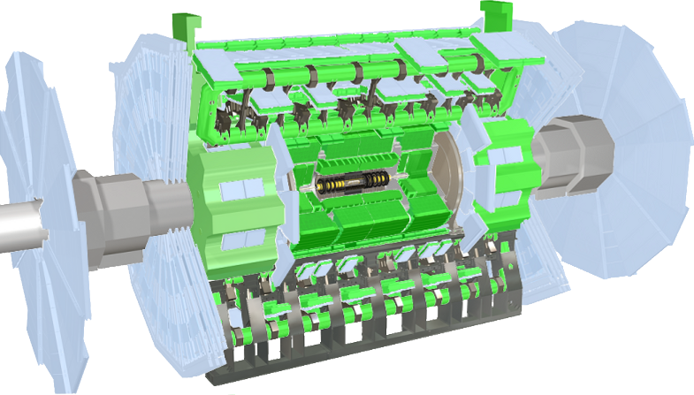
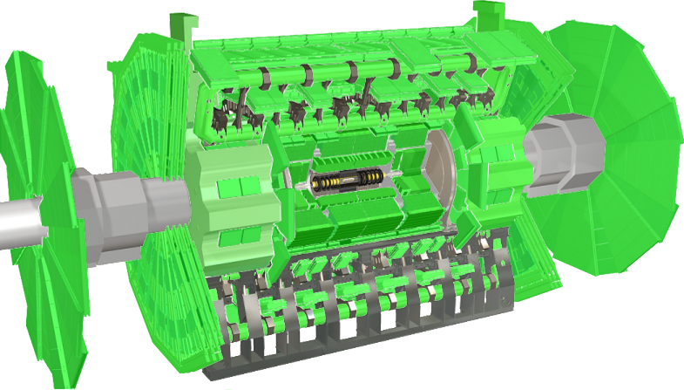


LHC Interaction
Synchronization of DCS with LHC operation and run control
Detector safety requires lower voltage levels during unstable beam conditions (beam injection, adjust, dump) =
State change  automated (atm except IBL/Pixel), synchronization with DAQ run control, should take max. 5 minutes
Audible notifications from DCS for important beam events
Beam backgrounds and luminosity monitored via DCS (LHC FSM tree)
STANDBY
STANDBY
READY
Stable Beams
Stable Flag
Train Injection
Beam Intensity
Collisions
Luminosity
Beam Energy
Energy Ramp
Drift Chamber HV
Pixel HV

Slide 12
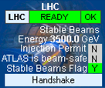
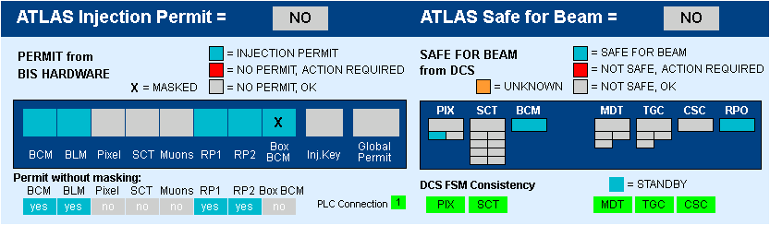
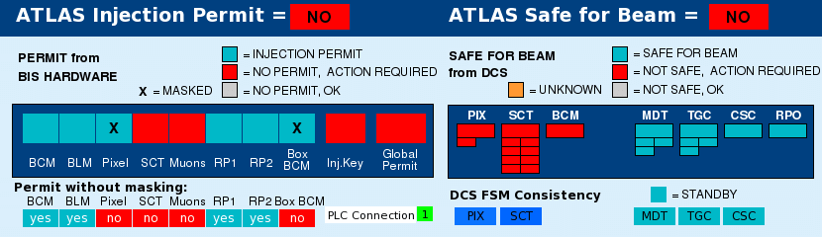
Beam Interaction – Details
Hardware permits vs. Software “safe for beam”
Hardware permits (left widgets) sometime generated via DCS
Software flags (right widgets) evaluate total sub-detector condition independent of FSM configuration
FSM states to x-check consistency
Right-click on widgets to get history (if archived)
Global
Software Flag
SCS
Software Flag
LCS
Software Flag

Slide 13
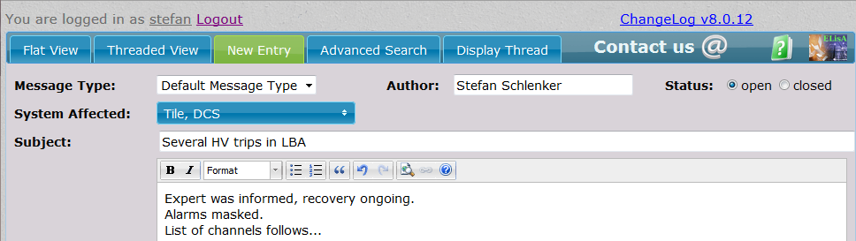
Shifter Tasks
Preparation
Check respective system documentation
In particular inform yourself about current problems and solutions, on-call numbers
Shift hand-over
Ask previous shifter about all remaining problems and possibly pending follow up
Check user interfaces to be available and configured, login with your account (FSM & Alarm screens)
During Shifts
Watch Alarm and FSM screen and follow up problems
Check actively with other shifters when suspecting problem cause in other systems,
Inform shift leader about possible impact of DCS problems on data taking efficiency
Report to ELOG:
Message Type = Default
System affected:
DCS + sub-detector
Desk | System Identifiers
ID | PIX, SCT, TRT, IDE
CALO+FWD | LAR, TIL, FWD, LCD, ZDC, RPO
MUON | MDT, CSC, RPC, TGC, MUO
DQ | LHC, LUM
SLIMOS | CIC, EXT, SAF, GCS
SHIFT LEADER | TDQ, GCS
System
assignment
(2015)

Slide 14
Shifter Tasks: Alarms
FATAL
Fatal failure, immediate attention required. Call.
ERROR
Failure condition which might prevent taking good data. Call.
Aim: Get / Keep alarm screen empty!
Procedure:
Follow up according to severity
Try to understand alarms, check documentation (= system shifters instructions and right-click alarm help) for specific procedures
If problem cannot be fixed, contact system expert
If alarm condition cannot be removed on short timescale (<~30min), mask alarm in agreement with expert or following specific instructions
If (masked) alarm condition cannot be removed on long timescale (>1week), expert is responsible to deactivate alarm or change alarm limits until problem is solved
Acknowledgeable alarms: acknowledge after informing expert
Report to ELOG what has been done, including details (list of alarms treated!)
WARNING
Minor problem. Upcoming failure which might be avoidable. Elog/maybe call.

Slide 15
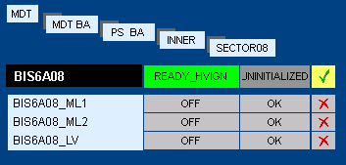
Shifter Tasks: FSM
Aim: Get / Keep FSM
Procedure:
Beginning of shift: check for tree being incomplete  no objects should show (excluded sub-trees), in case they do  contact expert
Understand problems (State!=READY, Status!=OK)
Navigate down to object causing the problem, check on respective panel
Check documentation for specific procedures
If problem cannot be fixed, contact system expert
If problem cannot be solved on short timescale (<~30min), Disable or Exclude only affected FSM object in agreement with expert or following specific instructions
Use with caution since this object will not receive global FSM commands nor will report further state/status changes, do not disable all children objects and leave parent enabled
Note: Exclude/Include can only be done on DCS desk, Disable/Enable on all FSM screens
Interventions on monitored trees should be done by handing over ownership from DCS desk to experts (Exclude), then Include sub-tree when intervention is over and check for tree completeness (= no )
Report to ELOG what has been done, including details (list objects/trees)
READY
OK
STANDBY

Slide 16


